Slide 1
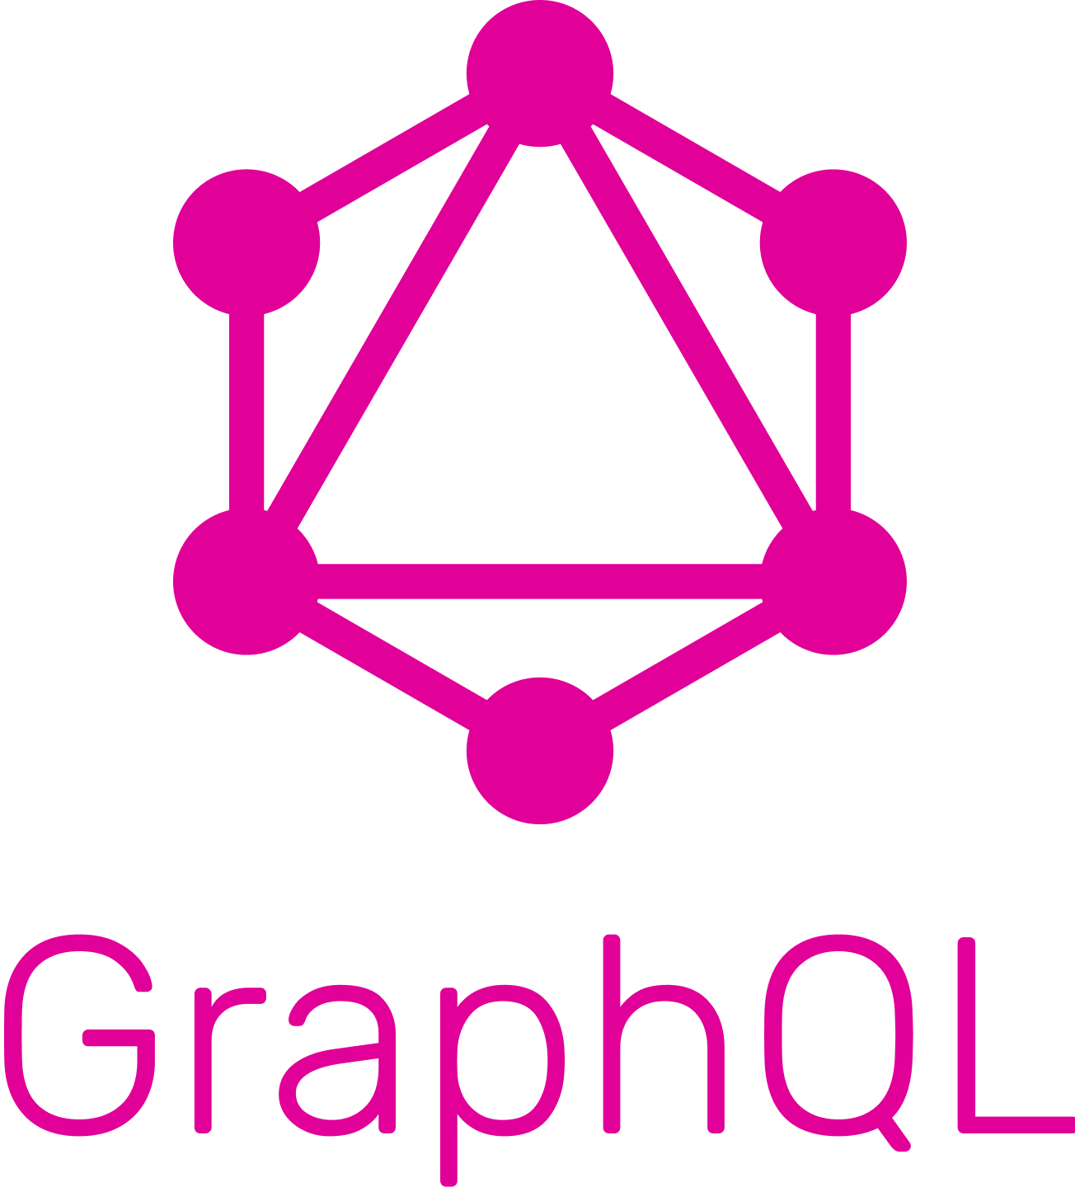
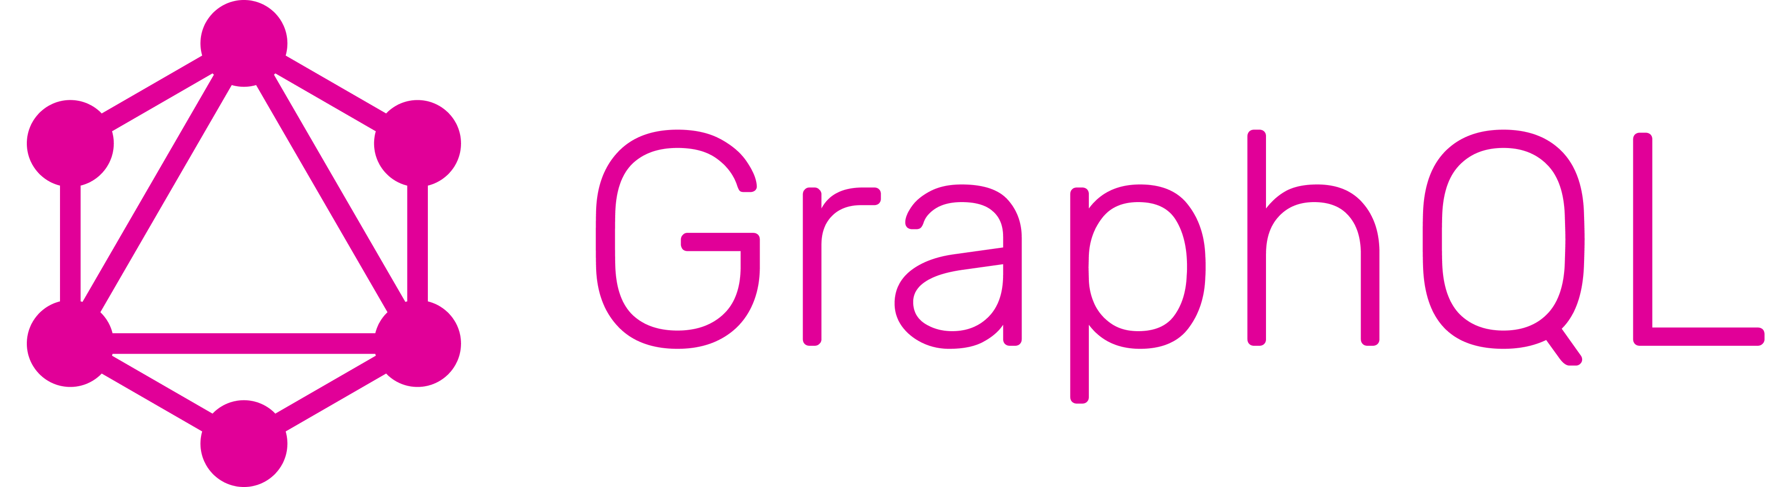
Mutations with large schemas
Nested mutations

Slide 2
Mutations at root only
query {
customerChequing(
customerId: "123"
) {
balance
}
customerSavings(
customerId: "123"
) {
balance
}
}
mutation {
updateCustomerChequing(input: {
customerId: "123",
delta: -100
}) {
balance
}
}
Namespace explosion.
Must be unique for each possible combination of:
Operation name (i.e. “update” here)
Context types (i.e. “Customer”)
Must also account for variations of inputs somewhere – mutation names or input args.
Long mutation names
Names hard(er) to guess + hard to find.
updateCustomerSavings(input: {
customerId: "123",
delta: 100
}) {
balance
}

Slide 3
Mutations at root only
query {
customerChequing(
customerId: "123"
) {
balance
}
customerSavings(
customerId: "123"
) {
balance
}
}
mutation {
updateCustomerChequing(input: {
customerId: "123",
delta: -100
}) {
balance
}
}
1st!
Respecification of context
Common input inherited or not?
Input type hierarchy?
Documentation repetition?
updateCustomerSavings(input: {
customerId: "123",
delta: 100
}) {
balance
}
2nd!

Slide 4
Mutations at root only
query {
customerChequing(
customerId: "123"
) {
balance
}
customerSavings(
customerId: "123"
) {
balance
}
}
mutation {
updateCustomerChequing(input: {
customerId: "123",
delta: -100
}) {
balance
}
}
1st!
Complicates transaction validation/finalization
Unscoped changes = root scope only.
updateCustomerSavings(input: {
customerId: "123",
delta: 100
}) {
balance
}
2nd!

Slide 5
No concurrent mutations. Says who?
query {
customerChequing(
customerId: "123"
) {
balance
}
customerSavings(
customerId: "123"
) {
balance
}
}
mutation {
updateCustomerChequing(input: {
customerId: "123",
delta: -100
}) {
balance
}
}
?
1st!
Data model?
Back-end implementation?
Federation middleware?
Client?
Spec? 👈
updateCustomerSavings(input: {
customerId: "123",
delta: 100
}) {
balance
}
?
2nd!
Server can execute queries any way it wants.
Server must execute mutations in order regardless of its abilities and clients’ requests?

Slide 6
But that’s dangerous, right?!
query {
customerChequing(
customerId: "123"
) {
balance
}
customerSavings(
customerId: "123"
) {
balance
}
}
What prevents clients (single or more) from executing multiple requests at the same time?
Who deals with that?
Spec? Federation middleware? Back-end implementation.
?
1st!
mutation {
updateCustomerChequing(input: {
customerId: "123",
delta: -100
}) {
balance
}
}
mutation {
}
?
2nd!
updateCustomerSavings(input: {
customerId: "123",
delta: 100
}) {
balance
}

Slide 7
Core philosophy of GraphQL?*
query {
customerChequing(
customerId: "123"
) {
balance
}
customerSavings(
customerId: "123"
) {
balance
}
}
?
1st!
“Mutual RESPECT”: RESPECTful API?
Servers will respect the clients and be clear about what they need and do.
Clients will respect the servers and be clear about what they need.
(Server should not have to guess or imply what clients want)
GraphQL Spec is to enable (1) and (2).
How do mutations and sequential execution specification fit?
* DISCLAIMER: My own, personal, view of this, not meant to be comprehensive.
?
2nd!
What prevents clients (single or more) from executing multiple requests at the same time?
Who deals with that?
Spec? Federation middleware? Back-end implementation.
mutation {
updateCustomerChequing(input: {
customerId: "123",
delta: -100
}) {
balance
}
}
mutation {
}
updateCustomerSavings(input: {
customerId: "123",
delta: 100
}) {
balance
}

Slide 8
Mutations… “unleashed”?
query {
customerChequing(
customerId: "123"
) {
balance
}
customerSavings(
customerId: "123"
) {
balance
}
}
mutation {
updateCustomer (input: {
customerId: "123”
}) {
}
}
updateChequing(input: {
delta: -100
}) {
balance
}
updateSavings(input: {
delta: 100
}) {
balance
}
Still 100% clear:
Servers do (only) what clients ask for, clients make no assumptions.
Nested namespaces = shorter, consistent, guessable names.
Clean root = entry points only.
Clear contexts, at any depth.
Input types simplified, less/no need for hierarchy.
Mutations simplicity: elementary mutations possible in addition to complex ones.

Slide 9



Servers’ “thoughts"
updateSavings(input: {
delta: 100
}) {
balance
}
query {
customerChequing(
customerId: "123"
) {
balance
}
customerSavings(
customerId: "123"
) {
balance
}
}
Even if we assume that nothing is serialized (including root mutations):
Transaction
mutation {
updateCustomer (input: {
customerId: "123”
}) {
}
}
updateChequing(input: {
delta: -100
}) {
balance
}
Preparation
Finalization

Slide 10
Spec changes required?
query {
customerChequing(
customerId: "123"
) {
balance
}
customerSavings(
customerId: "123"
) {
balance
}
}
Comprehensive list:
(Yep, that’s it. Just stop advising against nested mutations.)
updateSavings(input: {
delta: 100
}) {
balance
}
Transaction
mutation {
updateCustomer (input: {
customerId: "123”
}) {
}
}
updateChequing(input: {
delta: -100
}) {
balance
}
Preparation
Finalization

Slide 11


What are we doing here?
So…

Slide 12
Spec changes desired?
query {
customerChequing(
customerId: "123"
) {
balance
}
customerSavings(
customerId: "123"
) {
balance
}
}
Good guidance / documentation
  Draw attention to details.
  Implementation advice (servers, clients, middleware)
  Impact on @defer and @stream (implementation only)
  Subfields of controlled fields, while ”fetched” should not be
  given out before finalization (e.g. due to validation).
  Mutation is not followed by a fetch necessarily.
Way(s) for the schema to specify the behaviour
(for those who care to know)
Way(s) for the clients to request ordered execution
(for those cases when it matters)
updateSavings(input: {
delta: 100
}) {
balance
}
Transaction
mutation {
updateCustomer (input: {
customerId: "123”
}) {
}
}
updateChequing(input: {
delta: -100
}) {
balance
}
Preparation
Finalization

Slide 13
Sequentially executable?
query {
customerChequing(
customerId: "123"
) {
balance
}
customerSavings(
customerId: "123"
) {
balance
}
}
type Mutation {
foo(input: FooInput): FooOutput @sequentialAble
}
A field directive.
Looking for a better name.
Candidate proposal #1: “Sequentiality”
Not “serial” type but a field directive.
Makes types be reusable, esp. useful in federation.
Marks the nested mutations “orderable”, not the field itself in relation to others.
Servers could mark the Schema.mutation field the same way.
Indicates that clients can request sequential execution via matching client directive, not that it is implied.

Slide 14
How to request sequential execution?
query {
customerChequing(
customerId: "123"
) {
balance
}
customerSavings(
customerId: "123"
) {
balance
}
}
Yes, “array” brackets, not {… }. Easily associated with “order” by most.
mutation {
foo(input: {…})[ … ] or @sequential { … }
}
There is something better!
Alternative, more verbose but also more compatible.
Candidate proposal #1: “Sequentiality”
Servers must fail if they can’t obey (they don’t understand the request)
Using [ … ] would accomplish that 👆 but perhaps a bit too much:
  Root mutations are already required to be sequential, though deeper down they are not.
  Many endpoint servers will use sequential execution within a single request anyway to fairly serve concurrent requests. Middleware servers are more likely to do use concurrent execution.

Slide 15
Dependency-based ordering?
query {
customerChequing(
customerId: "123"
) {
balance
}
customerSavings(
customerId: "123"
) {
balance
}
}
mutation {
foo(input: …)@dependsOn(operation: $mutation.bar) {…}
bar(input: …){…}
}
Dots => not a variable
Or $$mutation.bar.far?
There is (or can be) more!
foo
“depends on”
Candidate proposal #2: “Deferred execution”
Implies that the operation should only be executed after another (specified) is complete.
Overrides default ordering (concurrent or otherwise).
Path literal would need to be decided (string, array, dedicated) but is pretty unambiguous.
Requires servers/schema to indicate support and must fail if they do not ($mutation.bar syntax will do that).
In federation the availability may be limited to some subgraphs only or may require more request splitting.
1. bar
2. foo
bar

Slide 16
Can inputs be tied to outputs?
query {
customerChequing(
customerId: "123"
) {
balance
}
customerSavings(
customerId: "123"
) {
balance
}
}
mutation {
foo(input: { far: $mutation.bar.far}){…}
bar(input: …){ far }
}
Dots => not a variable
Or $$mutation.bar.far?
“flow into”
bar
foo
far
far
Candidate proposal #2+: “Internally @defer / @stream outputs to inputs”
Requires a dedicated syntax to tie an input argument to an output field.
Scalars and enums would be already covered and useful, non-scalar types would require more work.
Clearly indicates that the dependent operation cannot proceed without its inputs being available.
In federation the availability may be limited to some subgraphs only or may require more request splitting.
1. bar
2. foo

Slide 17
Are those client directives supported?
query {
customerChequing(
customerId: "123"
) {
balance
}
customerSavings(
customerId: "123"
) {
balance
}
}
(A) field directives for better ”federability”
Looking for (a) better name(s).
schema {
query: Query
mutation: Mutation @sequentialAble @dependentExec @dataflow
} or: @features(dependencies: true, flow: true)
Or … maybe here?
Candidate proposal #3: “Server/schema abilities specification directive(s)”
Tell the clients that the execution directives are supported. Does this already exist? (I am not aware)
Tells federation middleware where it can use the feature(s) and where it has to split requests.
If not supported by the middleware, the federated schema would not indicate support for this = safe.
Some additional implementation complexity but extremely useful. Can be handled at the framework level.
Adding this to fields of (federated) shared types
Perhaps individual for each “feature”, perhaps a combined one with individual arguments.

Slide 18
Are those client directives supported?
query {
customerChequing(
customerId: "123"
) {
balance
}
customerSavings(
customerId: "123"
) {
balance
}
}
(A) field directives for better ”federability”
Looking for (a) better name(s).
schema {
query: Query
mutation: Mutation @sequentialAble @dependentExec @dataflow
} or: @features(dependencies: true, flow: true)
Or … maybe here?
Candidate proposal #3: “Server/schema abilities specification directive(s)”
Tell the clients that the execution directives are supported within. Does this already exist? (I am not aware)
Tells federation middleware where it can use the feature(s) and where it has to split requests.
If not supported by the middleware, the federated schema would not indicate support for this = safe.
Some additional implementation complexity but extremely useful. Can be handled at the framework level.
Adding this to fields of (federated) shared types? We can’t force support in all implementations.
Perhaps individual for each “feature”, perhaps a combined one with individual arguments.

